Slide 1






Student Dropout Risk & Education Retention Analytics System
An end-to-end analytics platform integrating academic performance, attendance patterns, and socio-economic indicators to enable proactive student intervention strategies
PYTHON
DATABRICKS
AIRFLOW
POWER BI
– Siddartha Samisetty
Notes:
1

Slide 2

The Challenge: Fragmented Data, Delayed Action
Siloed Data Sources
Student information is scattered in various academic, attendance, and demographic systems, which make holistic analysis difficult.
Reactive Identification
Dropout risk is identified only late in the semester-after opportunities to intervene have passed.
Manual Limitations
Spreadsheet analysis is time-consuming and incapable of rendering complex patterns across thousands of student records.
Missed Opportunities
Without early warning signals, the institutions lack the information and support to launch the initiatives on time.
Notes:
2

Slide 3

STRATEGIC GOALS
Project Objectives
01
To identify students who are at risk of dropping out at an early stage
02
To analyze academic performance, attendance, and socio-economic factors
03
To apply machine learning for predictive risk assessment
04
To automate alerts for timely intervention
05
To build dashboards that support decision-making for educators and administrators
Notes:
3

Slide 4
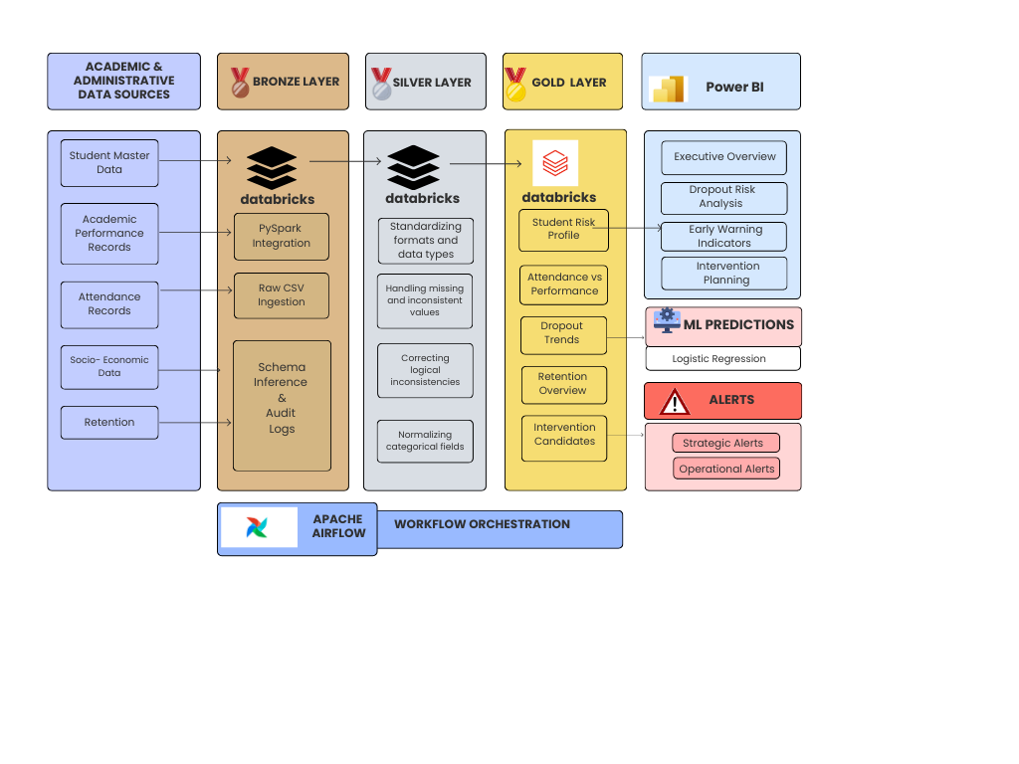
Data & System Architecture
Notes:
4

Slide 5
DATASET DESIGN
The datasets used in this project are synthetic but realistic, containing around 5,000–6,000 records.
The datasets include:
Student master data
Acts as the core dimension table, containing stable student attributes used to join all other datasets.
Academic performance records
Captures student academic outcomes across semesters and academic years.
Attendance information
Tracks student engagement and participation.
Socio-economic indicators
Represents external and demographic factors that influence retention.
Retention and dropout status
Captures the final outcome of student retention or dropout.
Intentional inconsistencies and missing values were added to simulate real-world data challenges.

Slide 6





MEDALLION ARCHITECTURE
The project follows the Medallion Architecture, which is a standard enterprise data engineering pattern.
It consists of:
Bronze Layer
Silver Layer
Gold Layer
Raw ingested data
Cleaned
and standardized data
Business-ready analytical tables
This approach ensures scalability, maintainability, and separation of concerns.

Slide 7
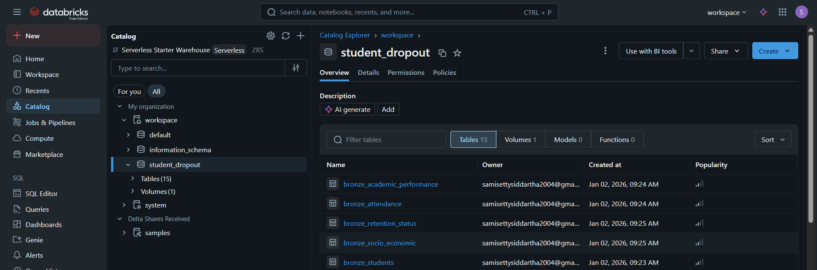
BRONZE LAYER
In the Bronze layer:
Raw CSV files are ingested using PySpark
Schema is inferred automatically
created timestamp and source system are added
No transformations are applied
This layer preserves the raw truth of the data for traceability.

Slide 8
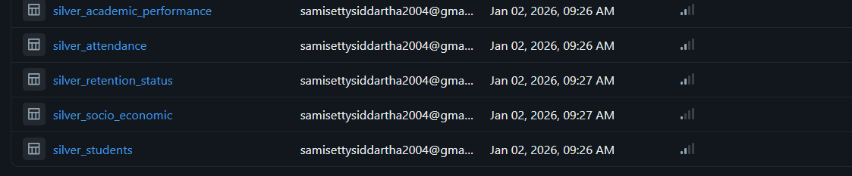
SILVER LAYER: DATA CLEANING, STANDARDIZATION & ENRICHMENT
The Silver layer is where raw data is transformed into analytics-ready datasets
Key activities performed in the Silver layer include:
Handling missing and inconsistent values,
Standardizing formats and data types
Correcting logical inconsistencies
Normalizing categorical fields to ensure uniform representation across datasets
It introduces derived and business-meaningful metrics.
The original ingestion timestamp is preserved
A new updated timestamp is added to capture transformation time
.

Slide 9
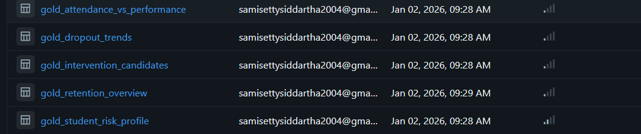
GOLD LAYER
The Gold layer contains analytics-ready tables designed for reporting and decision-making.
Key Gold tables include:
Student Risk Profile
Attendance vs Performance
Dropout Trends
Retention Overview
Intervention Candidates
These tables are optimized for dashboards, ML models, and alerts.

Slide 10
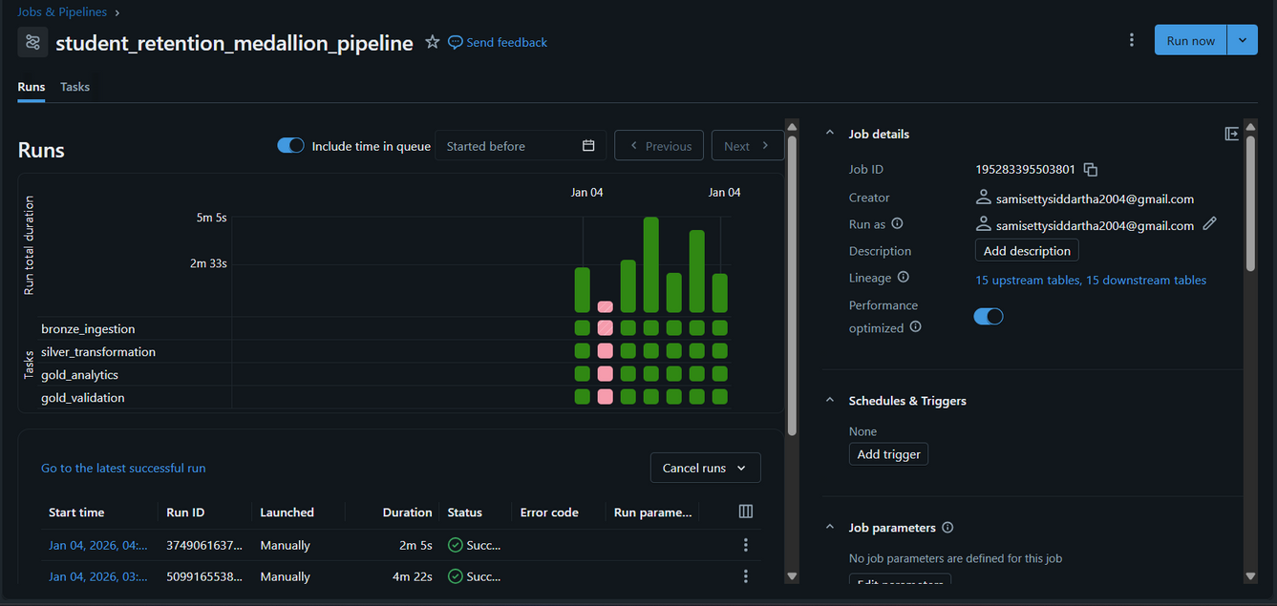
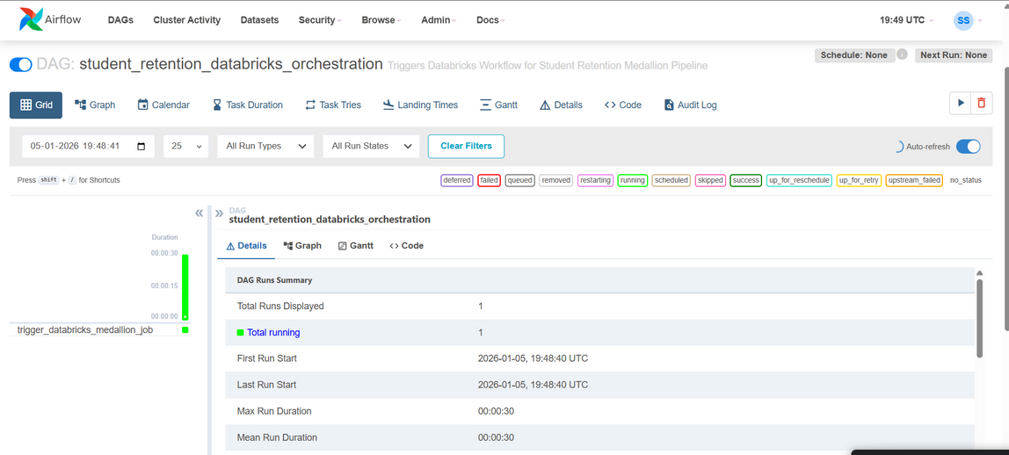
Workflow Orchestration
Bronze Ingestion
1
2
Silver Processing
Gold Analytics
3
Airflow
Apache Airflow is used to orchestrate the pipeline.
It:
Triggers Databricks Jobs
Controls execution order
Handles retries and monitoring
This enables reliable and repeatable pipeline execution
Notes:
7

Slide 11
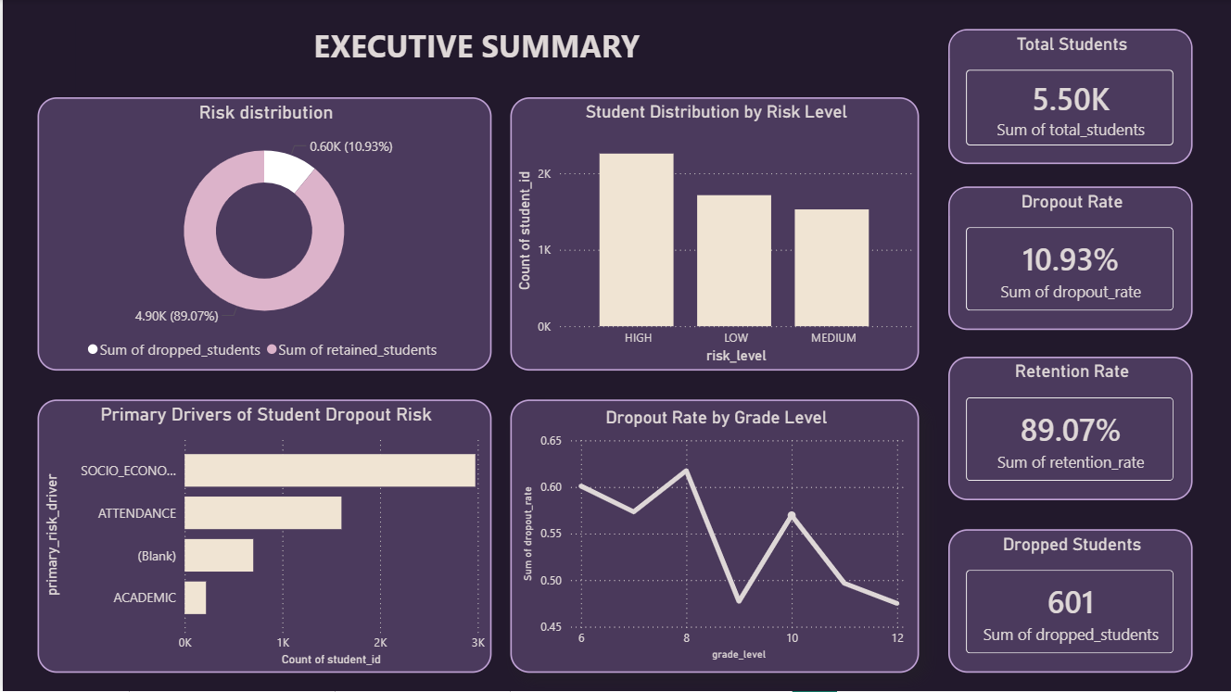
POWERBI DASHBOARDS
Notes:
8

Slide 12
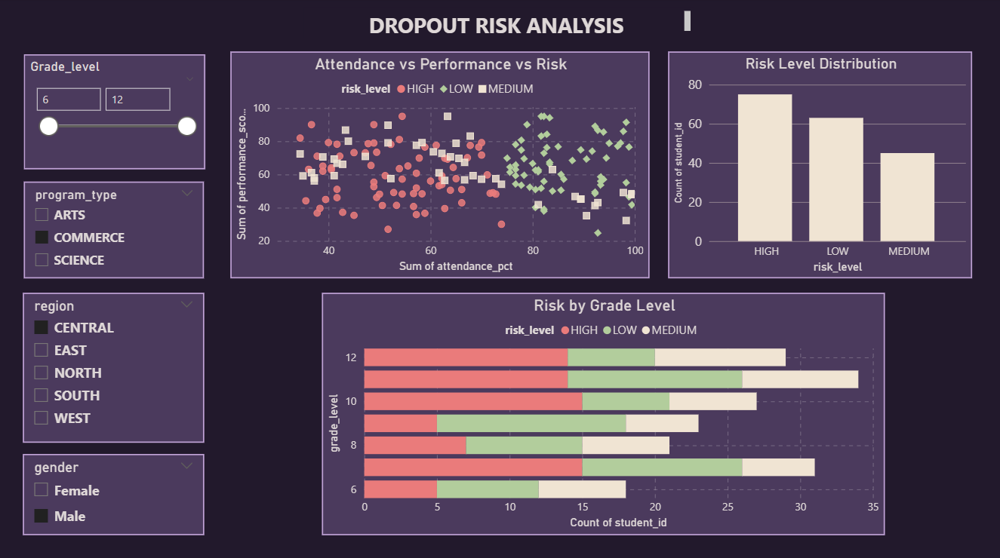
Notes:
8

Slide 13
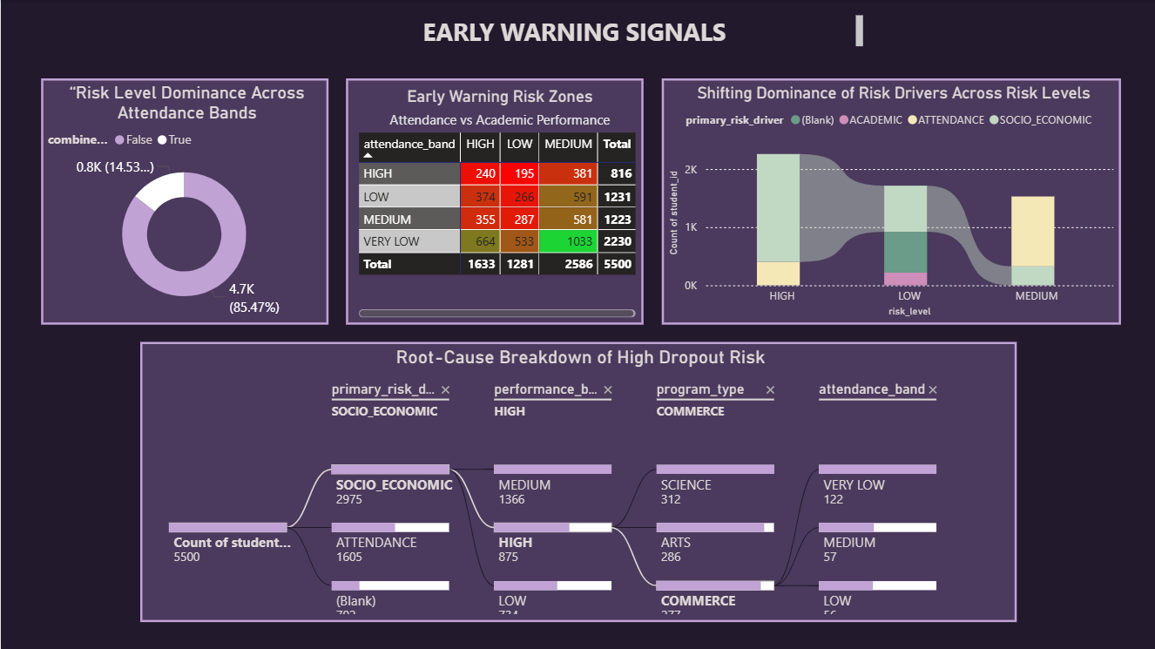
Notes:
8

Slide 14
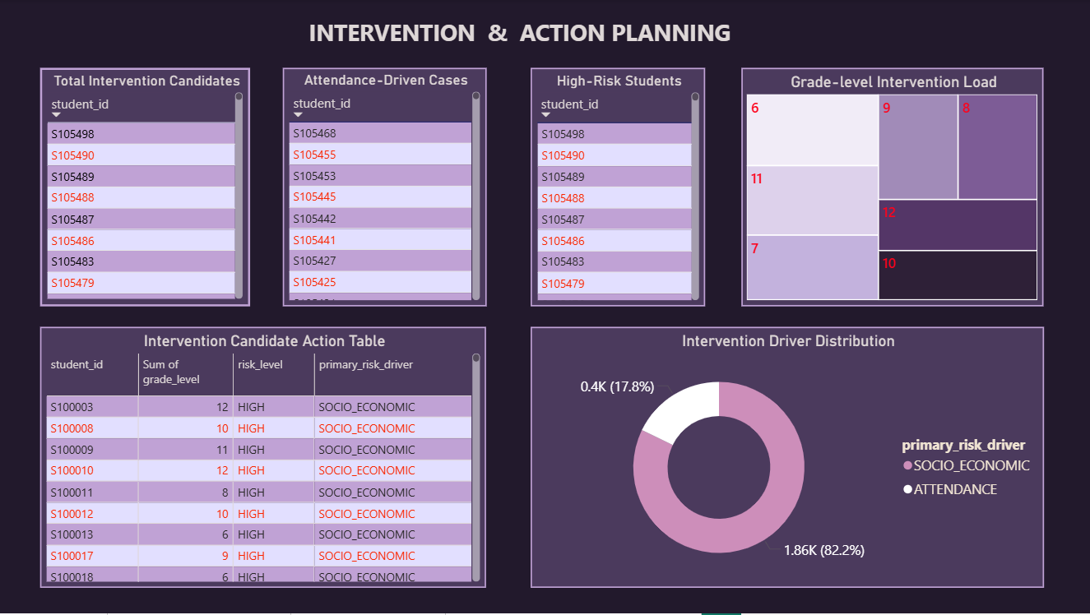
Notes:
8

Slide 15


DROPOUT RISK ANALYTICS
Dropout risk is calculated using:
Academic risk indicators
Attendance risk indicators
Socio-economic risk indicators
A composite risk score is generated and classified into:
Low Risk
Medium Risk
High Risk
Each student also has a primary risk driver to explain why they are at risk.

Slide 16
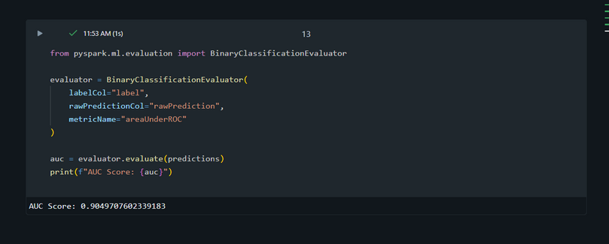
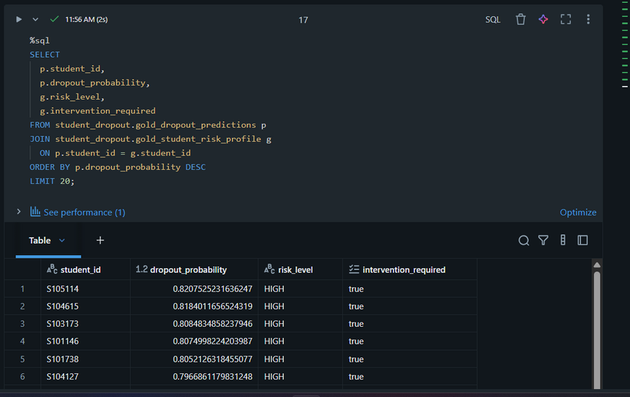
MACHINE LEARNING MODEL
A Logistic Regression model was implemented to predict dropout risk.
Reasons for choosing Logistic Regression:
Interpretable
Suitable for binary classification
Academically accepted
The model used Gold-layer features and achieved an AUC score of approximately 0.90, indicating strong predictive performance.

Slide 17

ALERTING STRATEGY
A dual-layer alerting strategy was implemented:
Operational alerts for immediate action
Strategic alerts for institutional monitoring
This separation prevents alert fatigue and supports different stakeholders.
Alerts are sent through Email

Slide 18
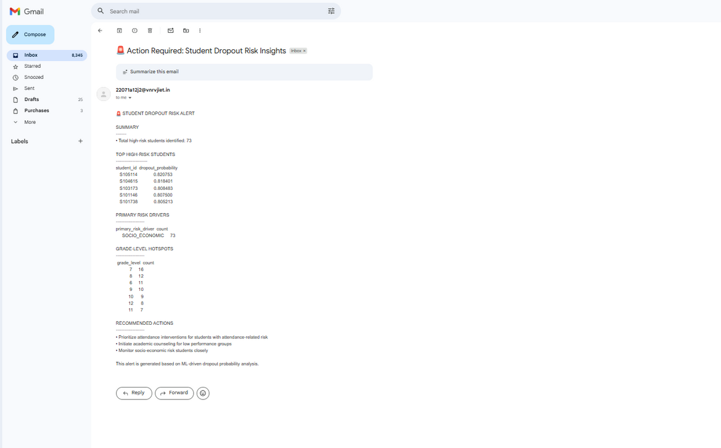
OPERATIONAL ALERTS
Email alerts are triggered for students with high dropout probability.
Each email contains:
Number of high-risk students
5 Top-risk students
Primary risk drivers
Suggested intervention focus
Grade level count
These alerts are meant for counselors and academic teams.

Slide 19
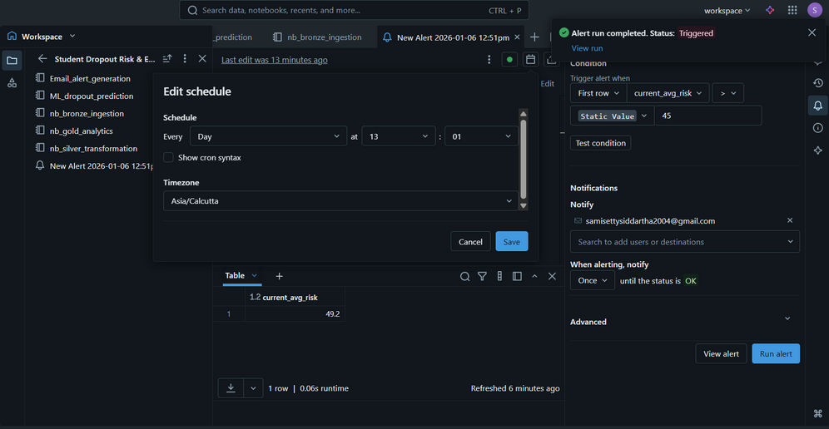
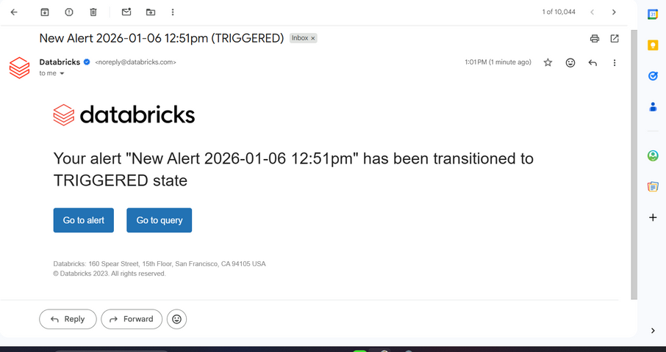
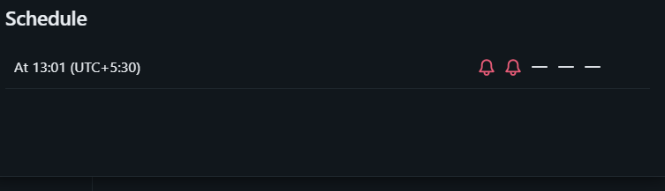
STRATEGIC ALERTS
A Databricks SQL, alert monitors institution-level risk drift.
It tracks:
Average student risk score
Baseline vs current risk
If risk exceeds a defined threshold, stakeholders are alerted.
This supports proactive governance and policy-level decisions.

Slide 20

Results & Business Impact
Enables timely identification of students who are likely to face academic challenges
Focused and meaningful interventions
Better retention planning
Reduced manual analysis and effort
Data-driven academic decision-making
Improved visibility at the institutional level

Slide 21

Future Enhancements
While the current system delivers a complete, enterprise-ready analytics solution, several enhancements can further improve its scalability, intelligence, and institutional impact.
Real-Time Data Ingestion
Advanced Machine Learning Models
Automated Intervention Workflows
Feedback Loop for Model Improvement
Integration with Learning Management Systems (LMS)
Role-Based Dashboards and Access Control

Slide 22

Conclusion
This project turns student data into clear insights that help identify at-risk students early and support better intervention. By combining analytics, machine learning, and dashboards, it enables smarter, data-driven decisions to improve student retention.

